Slide 1
./Burn2Earn_Unifi.py
Red Team Brad Welch 8/2018 Vap0r at quelabs.com @Vap0rz

Slide 2
Agenda
Unifi networks overview
Attack Vectors
Elaborate circle thing
Recon
Attack
Crypto stuff
Mitigation
Questions

Slide 3
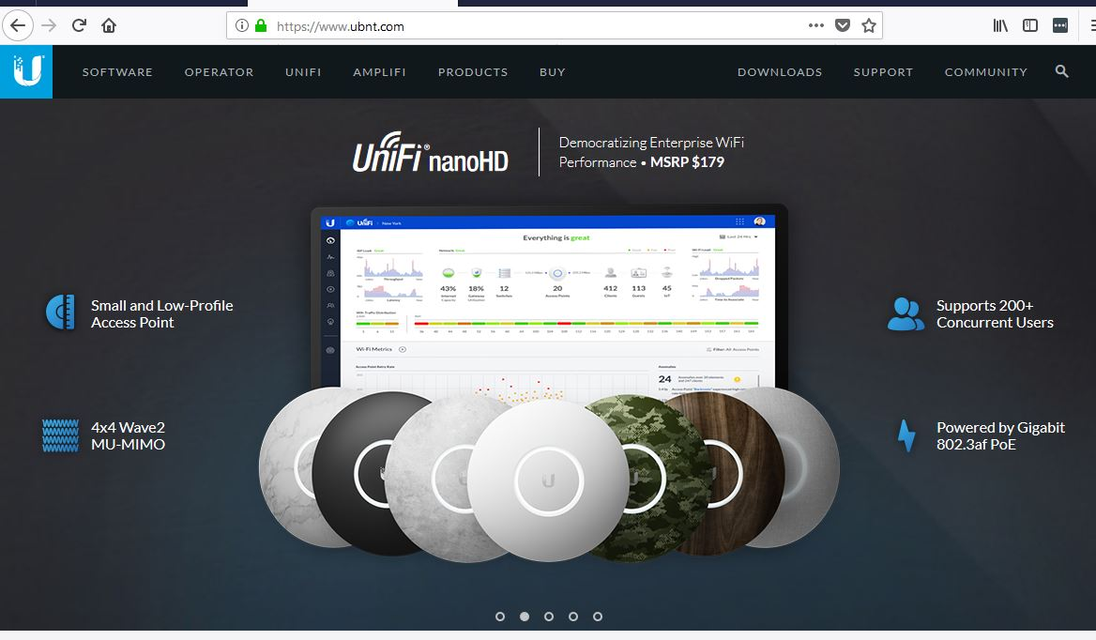
Enterprise Grade Hardware

Slide 4
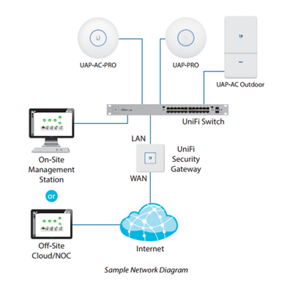
Typical Simple Unifi Netwreck

Slide 5
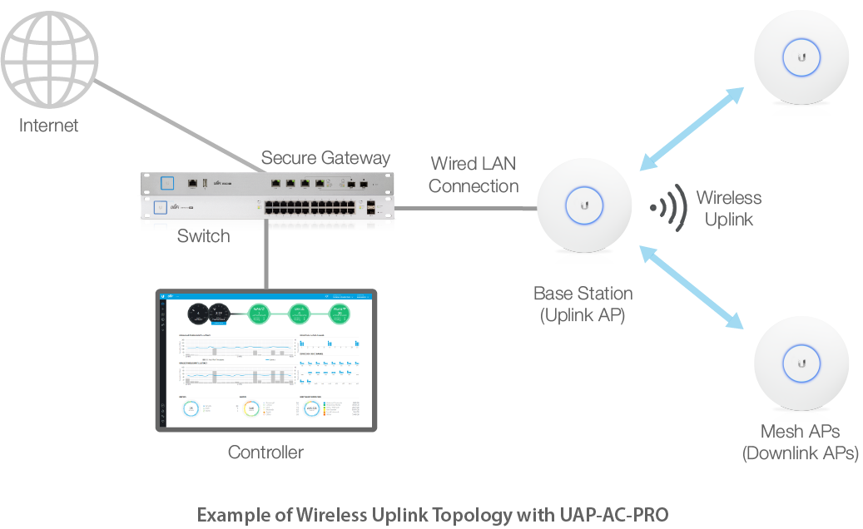
Overview of Simple Unifi network

Slide 6
Function of a Unifi Controller
The UniFi Controller is a wireless network management software solution from Ubiquiti Networks™. It allows you to manage multiple wireless networks using a web browser. The controller is for use with version 3.2 or above of the UniFi Controller software and all of the UniFi Enterprise WiFi System Access Point models. Additional information about the AP models is available on their website at
http://documentation.ubnt.com/UniF

Slide 7
Controller is just software (jar)
The UniFi Controller software is installed just once when
you initially create a UniFi network. UniFi APs can be
added at any time through the controller interface but
you do not need to go through the software installation
process every time you add another UniFi AP

Slide 8
Not able to test for all scenarios
Not enough equipment at home to test how the Unifi controller manages or interfaces with Unifi edge routers or their security gateway products. Ubiquiti has been notified (responsible disclosure) treat as internal information only.

Slide 9
The Problem
Someone forget the controller Admin password
Factory reset causes more headaches, less fun

Slide 10

Attack Vectors
Brute force Unifi controller web login
Brute force SSH directly on AP device
Review traffic between controller and AP
Other ways?
Attack host running the jar?
Perhaps attacking the jar itself?

Slide 11
Official organic phase circle thing
04
Recon
Attack
What can we poke at?
Break it
01
03
Evaluate
Profit
Low hanging fruit first
#Winning
02

Slide 12

Fast Recon
Focused on local machine running the jar for controller interface
What services are created when the jar is spun up?
Any temporary files written to disk?
Registry changes?
Are there any call home attempts (Unifi K_loud key)
Additional listening ports?

Slide 13
New Listening Ports
Obvious new web UI port 8443 (HTTPS)
New port used to connect to the actual AP device?
New port listening on 27117 (sounds familiar)
27017 is the default DTIOT (Mongo DB)
Death To Internet Of Things port
Port bound to local host only
While Unifi is not really IOT, this is very typical of small embedded IOT devices

Slide 14
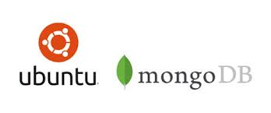
Thanks for the Mongo
Fairly familiar with Mongo as several IOT devices leverage it, usually in a very insecure way.
Several tools allow you to connect to Mongo my preferences:
RazorSQL
Robot 3T (free version)

Slide 15
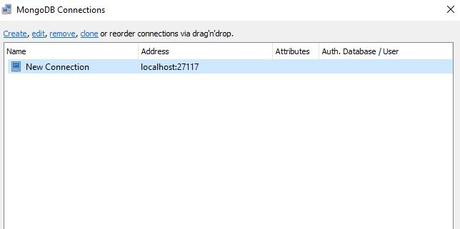
Ready up, lets go
Using R3T connect to Mongo on localhost

Slide 16
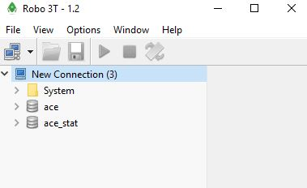
Where we are going, we don’t need the key
Using R3T connect to Mongo on localhost
No Authentication (Thank you)
Ubuiqiti says they are assuming user is authenticated because it’s only available on the local machine

Slide 17
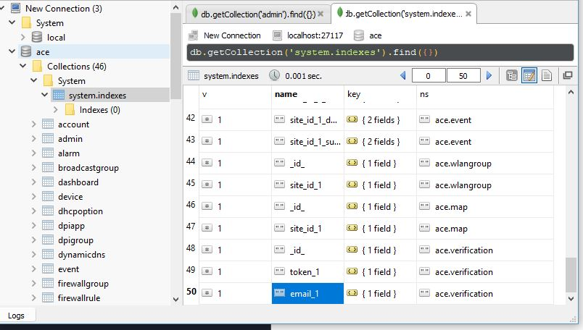
Where we are going, we don’t need the key
No auth
Not entirely sure what ACE is but looks fun

Slide 18
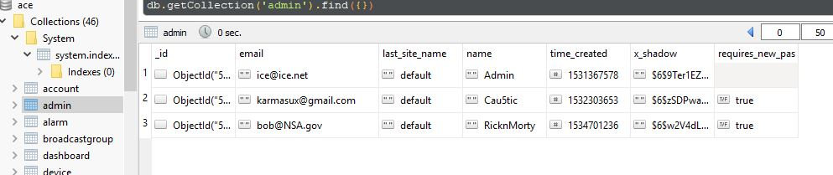
Target Spotted
Primarily looking for authentication types or user accounts
Hashes
Auth Keys
Clear text passwords
Anything stick out here?

Slide 19
All the Loot
x_shadow looks to be a hash but poor screenshot skills prevented the ability to notice that here
X_shadow all three values start with $6
Look familiar?

Slide 20
$6 -Really?
Looks like a common header when using crypto libs
Denotes SHA-512
ID | Method 1 | MD5 2a | Blowfish 5 | SHA-256 (since glibc 2.7) 6 | SHA-512 (since glibc 2.7)
We now have a pretty good guess it’s using SHA-512

Slide 21
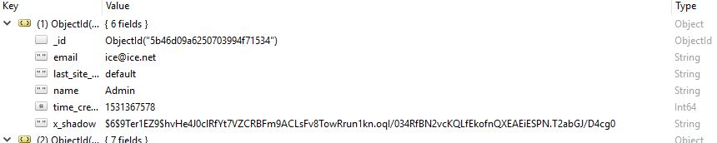
What else is in x_shadow
After the SHA-512 indicator there looks to be another string
Any thoughts?

Slide 22
What else is in x_shadow
After the SHA-512 indicator there looks to be another string
HINT:
What would be awesome to have stored with the hash if you are wearing a black Defcon hoodie?

Slide 23


Slide 24

Educated guessing, what we believe
We have read/write access to the Mongo (no auth)
We believe we know the Cryptographic Hash Algorithm (SHA-512)
Perhaps we have the salt used for hashing
This will be a different salt each time/user
We can start with the default number of cycles or rounds (usually 5000) for hashing

Slide 25
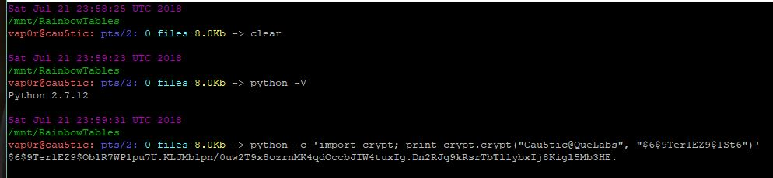
Using python to hash
Crypt module is usually installed on most major Linux distro’s
I’m using Python 2.7.x because 3 is for those that can’t use VI and enjoy spending time fixing deps

Slide 26
Using python 1 line to hash
python -c ‘import crypt; print crypt.crypt(“password”, “$6SALT”)’
Output is your new hash assuming the default rounds were 5000
I prefer python crypt but there are several ways to generate our hash

Slide 27
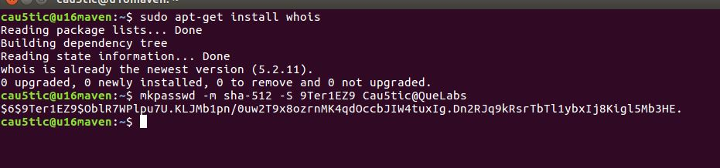
Always another way
python -c ‘import crypt; print crypt.crypt(“password”, “$6SALT”)’
mkpasswd -m sha-512 -S 9Ter1EZ9 Cau5tic@QueLabs
Mkpasswd is provided by the whois package (apt-get)
No clue how to do this on windows natively

Slide 28
Changing rounds or cycles
python -c ‘import crypt; print crypt.crypt(“password”, “$6rounds=9000SALT”)’
mkpasswd -m sha-512 -S 9Ter1EZ9 -R 9000 Cau5tic@QueLabs
Mkpasswd is provided by apt install whois
Still no clue how to do this on windows natively

Slide 29
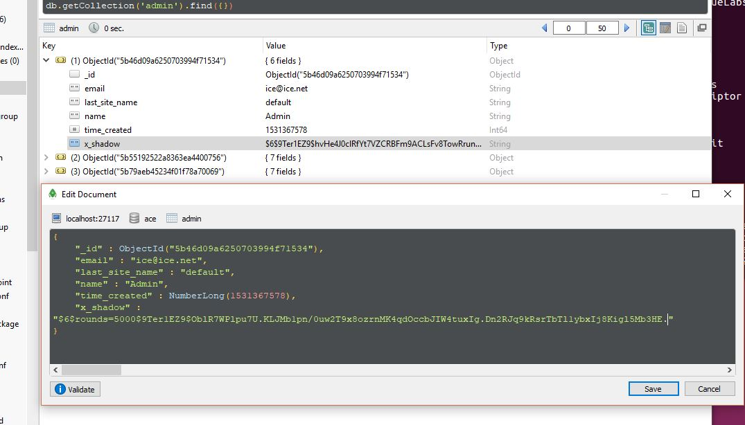
And then...
Now that we have a new hash, paste the entire value back into Mongo DB as the x_shadow value under admin and save.

Slide 30
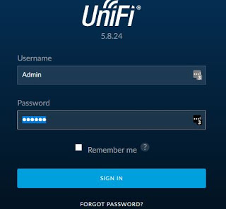
Profit

Slide 31
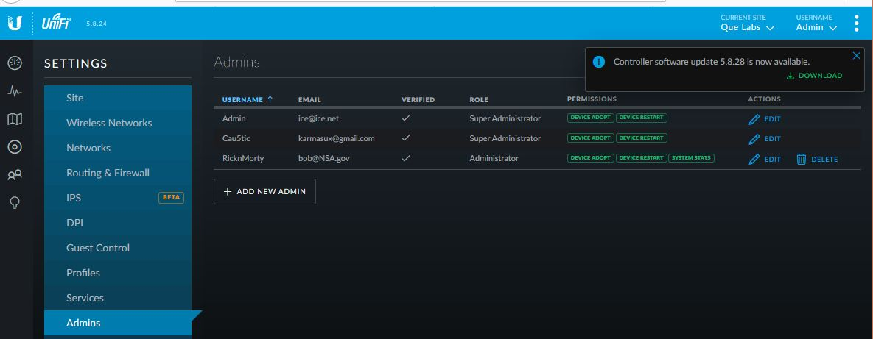
Profit

Slide 32
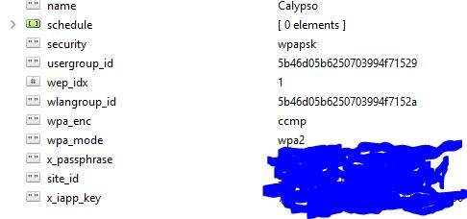
What else can be changed?
Change the WPA2 PSK (It’s in plain text)

Slide 33
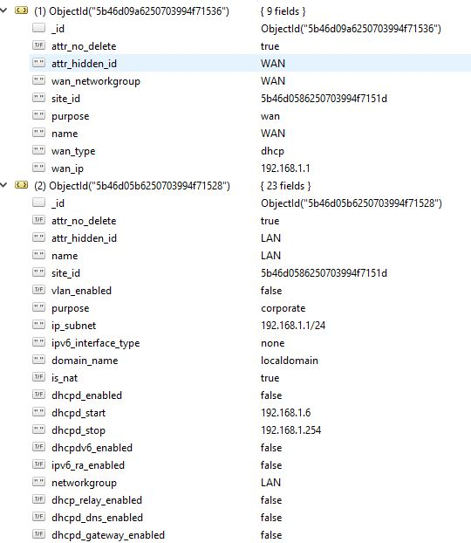
What else could you change?
Change DHCP scope

Slide 34
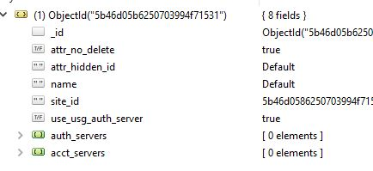
What else could you change?
Radius auth servers maybe?

Slide 35
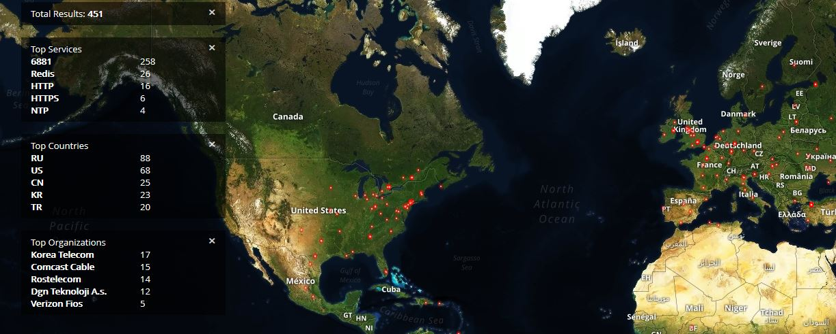
Typical attack vector
This is a very common attack vector for IOT:
Mongo DB with no Auth
Hash in the db with the algorithm type and salt +10 security
Usually bound to local internal interface only

Slide 36

Mitigation Strategies
Force authentication on local database
Encrypt the database to prevent offline attacks
Remove salt value from the actual stored hash
Ensure that the database port is not exposed externally

Slide 37

Questions?

